Slide 1
Hy Flex Course Delivery
Steve Robinett, Great Falls College

Slide 2
What is Hy Flex?

Slide 3
Course delivery with options!
As a student, you choose how you attend class in one of 3 modalities
Face to Face as scheduled (F2F)
Remote synchronous via a Live Stream feed
Remote asynchronous via recorded class sessions

Slide 4
Why are we doing this?
Hy Flex widens your choices to attend college courses
Allows us to be more agile in the age of Covid
This is model is being used nationally at institutions both large and small
This course is being run as a Hy Flex pilot at Great Falls College. You will not see this in any other classes this block.

Slide 5
Modalities defined
Face to Face (F2F): The classic model. We meet each day with live lecture and instructor-led activities.
Remote Synchronous (RS): You will attend via a Livestream (in real time) via YouTube. Links to the Livestream will be posted to MS Teams chat before each class session. You will have opportunity to ask questions via MS Teams chat.
Remote Asynchronous (RA): You will watch the recorded Livestream via YouTube at your convenience.

Slide 6
Pros and cons
Pro
Con
Flexibility for scheduling, weather, COVID
You can choose the modality that best suits you
You can “mix and match” on any given day
So many choices!
You may need to find the modality that best suits you
Feel free to discuss with me
If not F2F, harder to ask in-class questions

Slide 7
Items of note
Class will still meet F2F each day as scheduled
If you choose remote sync / asynch, it is assumed you have access to required equipment and sufficient bandwidth for a Livestream event.
Regardless of chosen modality, your requirements will remain the same (assignments & quizzes)
Schedule of assignment due dates will not change

Slide 8
Pilot run CSCI 100
Fall 2020

Slide 9
CSCI 100 Intro to programming
Good combo of direct instruction and hands-on
Lots of instructor-led lab time
8 students

Slide 10
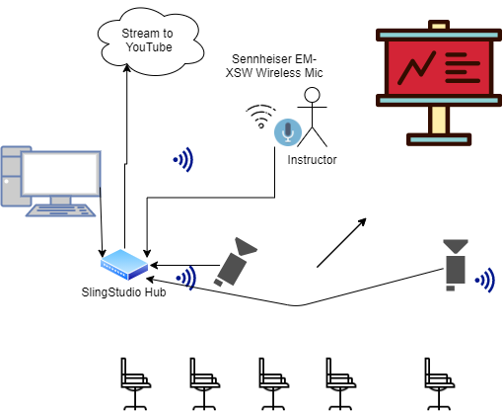
Classroom
Setup

Slide 11
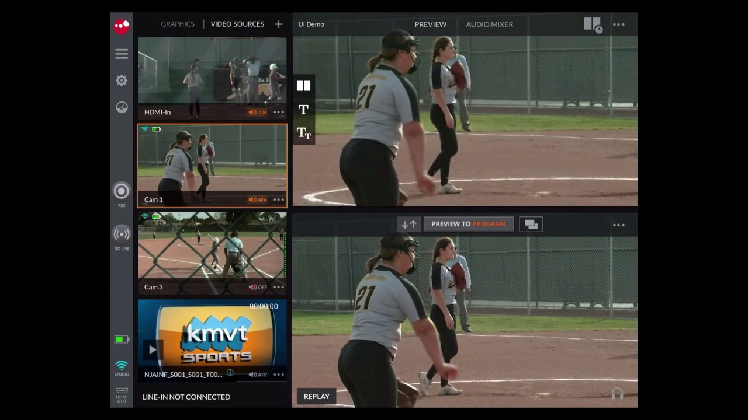
SlingStudio Console App

Slide 12
Pretty good practices
F2F Orientation- Day 1
Narrated PPT overview
Dry Run of Live Stream - Day 1
Use of MS Teams to track remote synchronous attendance
Remote Sync students post to a channel to announce presence
Setup Live Stream 10 min before class and use an on-screen countdown timer
Live Stream Link posted to MS Teams channel

Slide 13
Participation

Slide 14
Issues / problems
Week 1 – some classroom tech glitches. Stable thereafter
LiveStream has ~ 10 second latency- hard to field remote questions verbally in real-time
MS Teams chat needs a dedicated monitor
Difficult to track attendance for remote asynchronous students (Link visits on D2L)

Slide 15
Artifacts to follow
Slide Deck for Hy Flex Orientation
Video link to narrated Slide Deck
Bill of Materials for Sling Studio setup

Slide 16
Thanks for your time!
Steve

